Slide 1
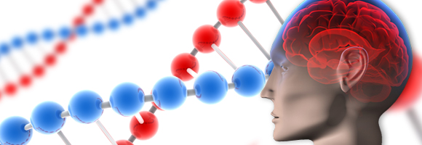
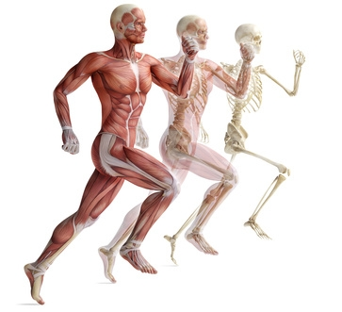
Cell Transport
Passive …

Slide 2
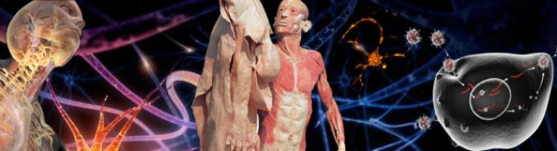

By the end of today’s lesson you will know that:
1. The structure of the cell membrane is specific designed to allow the movement of materials in and out
Your body uses two types of transport, active and passive.
Define active and passive transport.

Slide 3
In order for cells to function chemical and nutrient must be brought into the cell, waster removed and messages sent.
This occurs at the cell boundary.

Slide 4
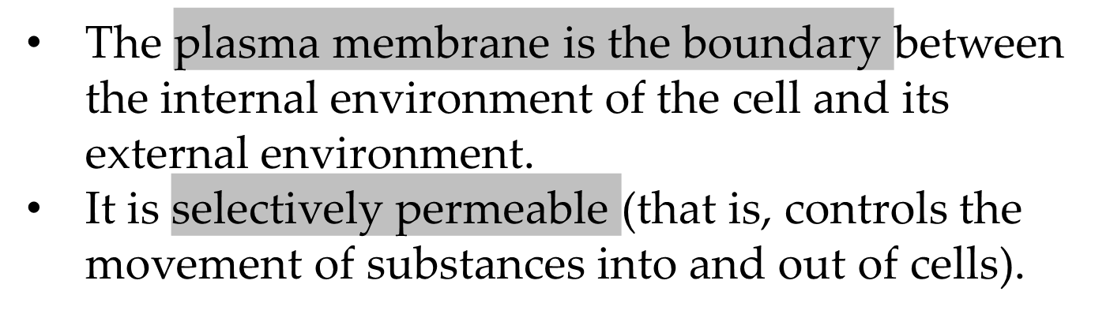
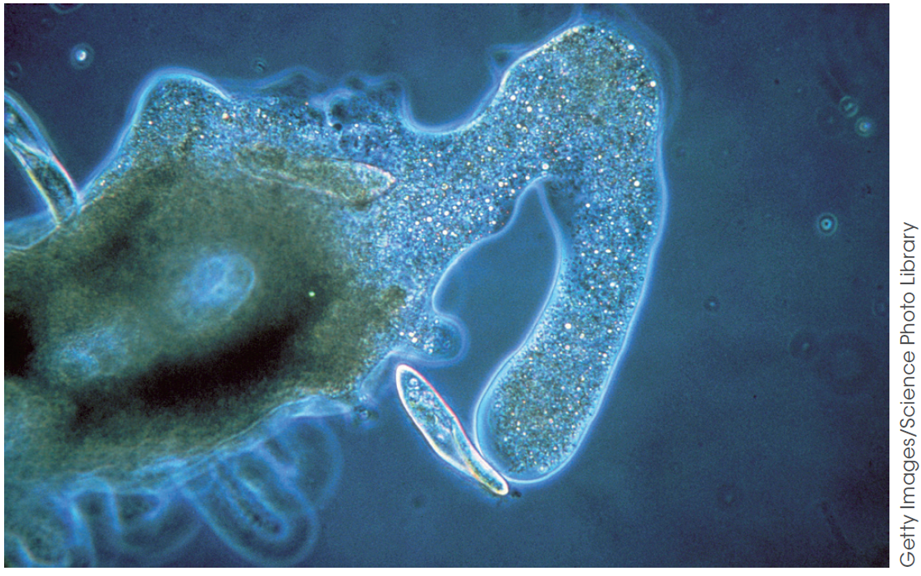
Cell plasma membrane
The plasma membrane: the boundary of cells
Figure 8.2
An Amoeba engulfing food demonstrates the flexibility of the plasma membrane.

Slide 5
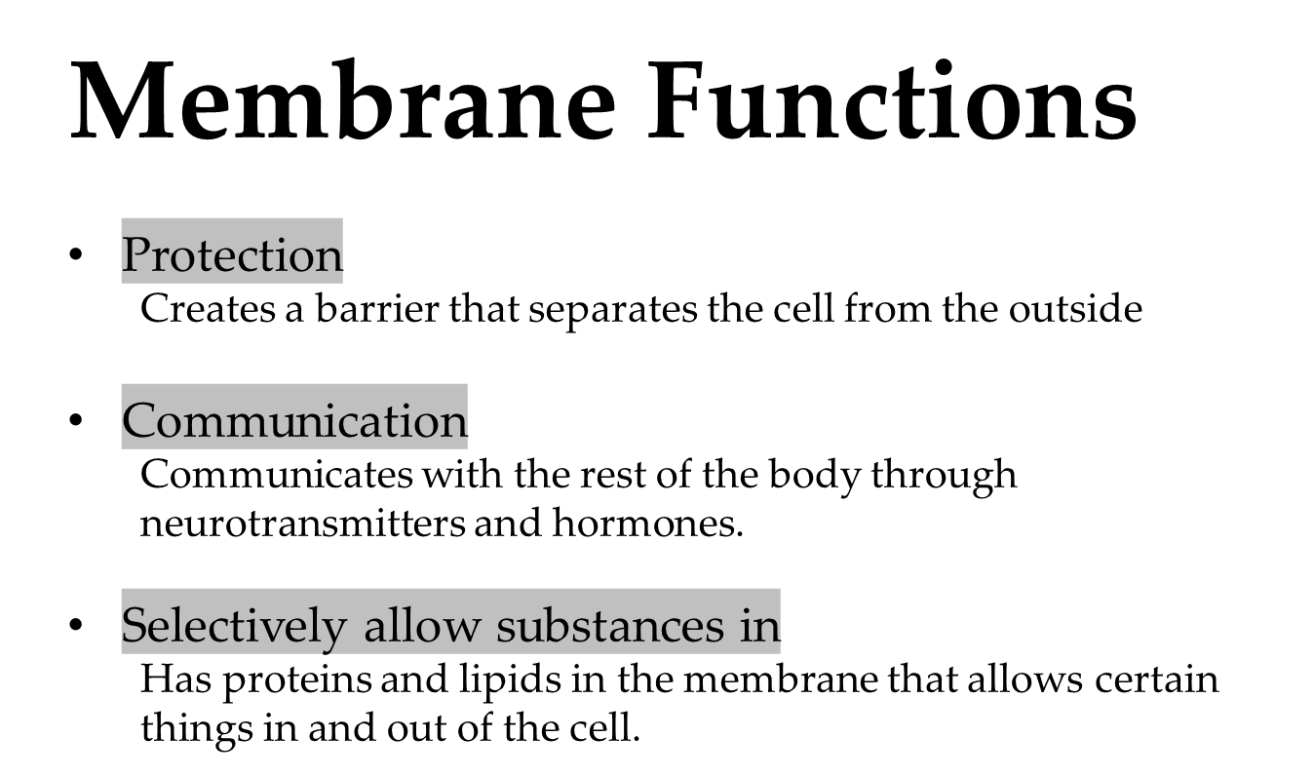

Slide 6
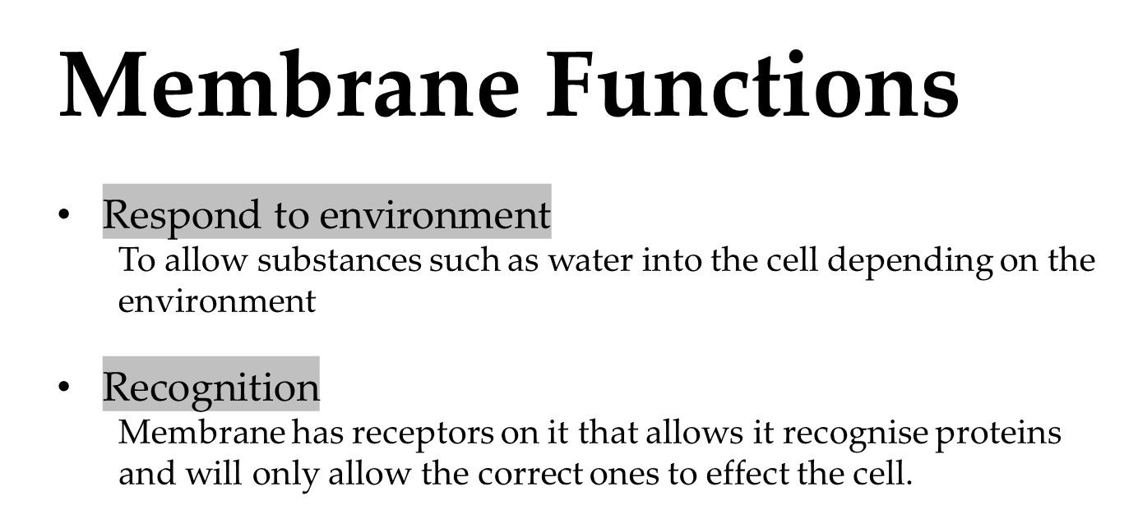

Slide 7
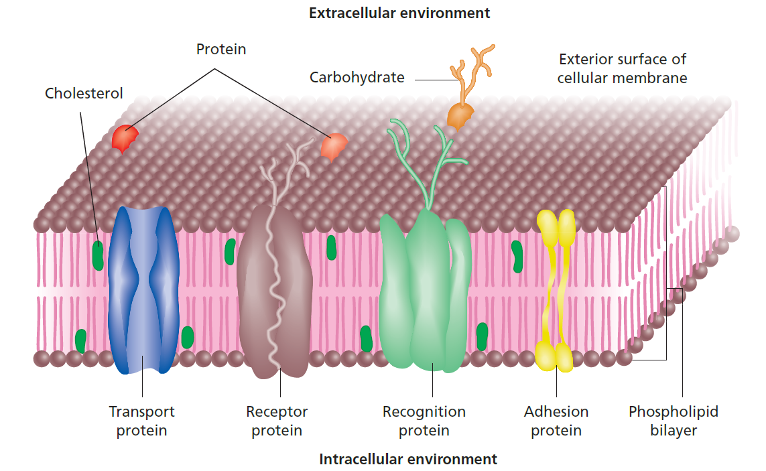
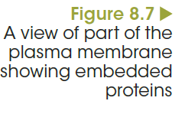
Structure of a cell membrane
Notes:
Adhesion proteins link cells together to maintain both the three-dimensional structure and the normal functioning of tissues.
Transport proteins act as passageways that allow specific substances to move across the membrane. An example is the rapid movement of ions across the membrane when a nerve is stimulated.
Membrane proteins are also involved in cellular communication. Receptor proteins bind hormones and other substances that cause changes to the cell’s activities.
Membrane recognition proteins, which are called glycoproteins because they combine with a sugar molecule, are unique to each individual. They act as markers, called antigens, which allow the immune system to distinguish between the body’s own ‘self’ cells, and foreign invaders (‘non-self’ cells).

Slide 8
Movement across the membrane
Materials moved across the membrane via two processes:
Passive Transport
Active Transport
Notes:
Adhesion proteins link cells together to maintain both the three-dimensional structure and the normal functioning of tissues.
Transport proteins act as passageways that allow specific substances to move across the membrane. An example is the rapid movement of ions across the membrane when a nerve is stimulated.
Membrane proteins are also involved in cellular communication. Receptor proteins bind hormones and other substances that cause changes to the cell’s activities.
Membrane recognition proteins, which are called glycoproteins because they combine with a sugar molecule, are unique to each individual. They act as markers, called antigens, which allow the immune system to distinguish between the body’s own ‘self’ cells, and foreign invaders (‘non-self’ cells).

Slide 9
There are two forms of passive transport that occur in cells:
Diffusion
Osmosis

Slide 10
Diffusion
Movement of particles from where they are in high concentration to where they are in low concentration,
It is passive and does not require energy.
Notes:
Materials can move across membranes either with or without the expenditure of energy.
Movement that does not require energy is called passive transport.
Diffusion is the net movement of particles from a region of high particle concentration to a region of lower particle concentration.
The difference in particle concentration between the two regions is called the concentration gradient. Diffusion always takes place wherever such a gradient exists and continues until the particles are distributed evenly throughout the system. When that happens, equilibrium is said to be reached. Particles will continue to move randomly, but at equilibrium they move at equal rates in all directions.

Slide 11
Diffusion
Diffusion is used for the movement of small molecules such as oxygen and carbon dioxide across cell membranes.
Notes:
Materials can move across membranes either with or without the expenditure of energy.
Movement that does not require energy is called passive transport.
Diffusion is the net movement of particles from a region of high particle concentration to a region of lower particle concentration.
The difference in particle concentration between the two regions is called the concentration gradient. Diffusion always takes place wherever such a gradient exists and continues until the particles are distributed evenly throughout the system. When that happens, equilibrium is said to be reached. Particles will continue to move randomly, but at equilibrium they move at equal rates in all directions.

Slide 12
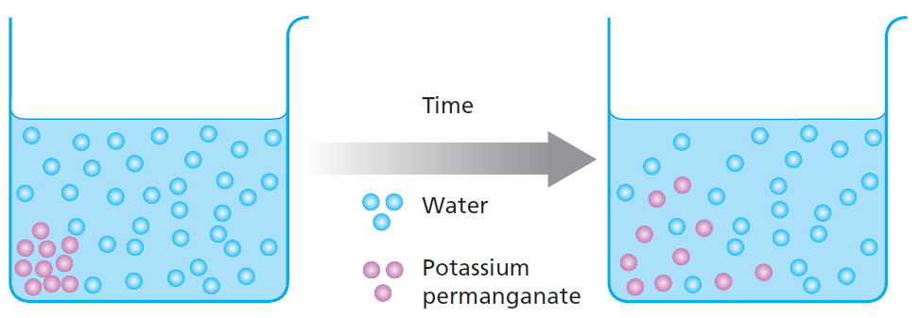
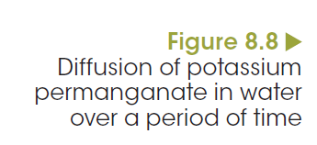
Diffusion

Slide 13
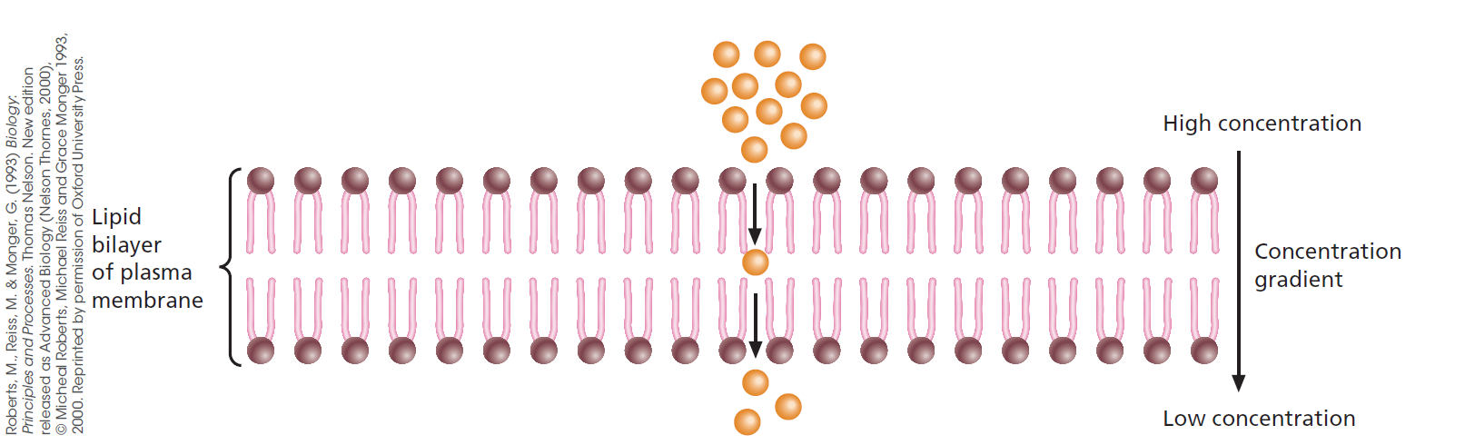
Diffusion of oxygen across membranes
Notes:
Substances like oxygen, water, carbon dioxide and other small, uncharged particles move easily through the plasma membrane of a cell by simple diffusion. Figure 8.9 shows these particles passing between the phospholipid molecules from a high to a low concentration. Oxygen always tends to diffuse into cells because their use of oxygen in cellular respiration maintains a low concentration in the cytoplasm.

Slide 14
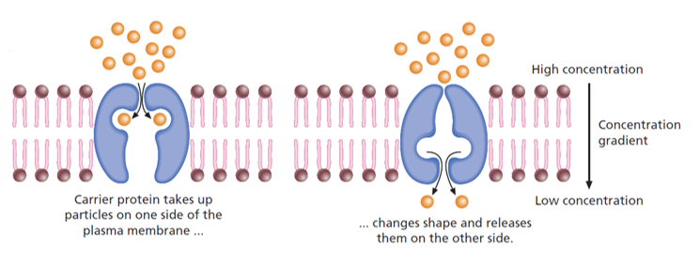
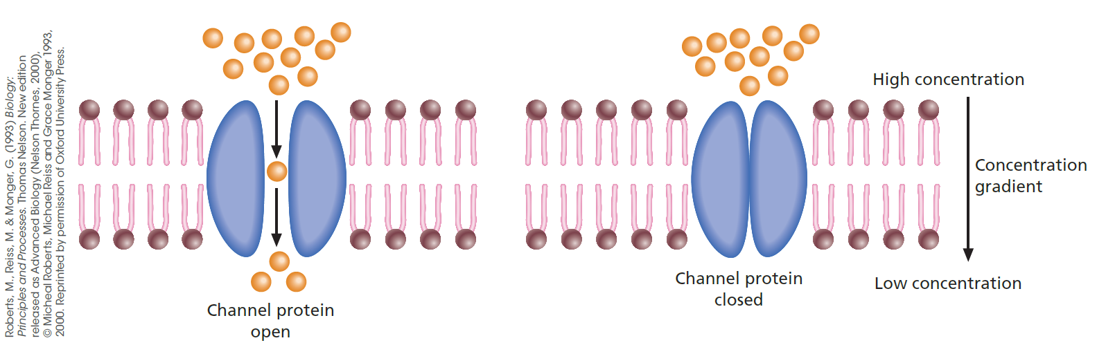
Facilitated diffusion openings controlled by the cell
Notes:
Charged particles, such as sodium and chloride ions, and relatively large molecules, such as glucose and amino acids, do not pass through the phospholipid bilayer readily. There must be some way to help them enter the cell. In the plasma membrane, certain proteins assist such particles to diffuse into the cell. This process is called facilitated diffusion.
Two types of protein are involved in facilitated diffusion: carrier proteins and channel proteins. Carrier proteins bind to specific molecules on one side of the membrane, change shape and release the substance on the other side (Figure 8.10). An example is the glucose transporter protein, which is located in the plasma membrane of all mammalian cell types and carries glucose in either direction, depending on the direction of the concentration gradient.
Channel proteins form narrow passageways through which small ions can diffuse rapidly from a high ion concentration to a lower ion concentration (Figure 8.11). Only ions of a specific size and shape can pass through a particular channel protein.

Slide 15
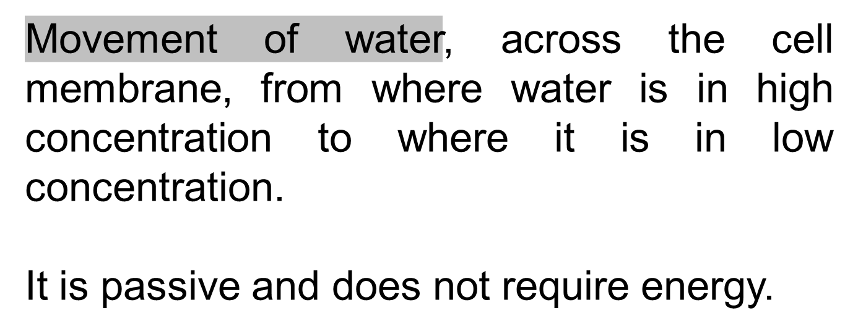
Osmosis

Slide 16
Osmosis is important because cells are surrounded by water molecules.
The number of water (H₂O) molecules inside and outside the cell must be equal.

Slide 17
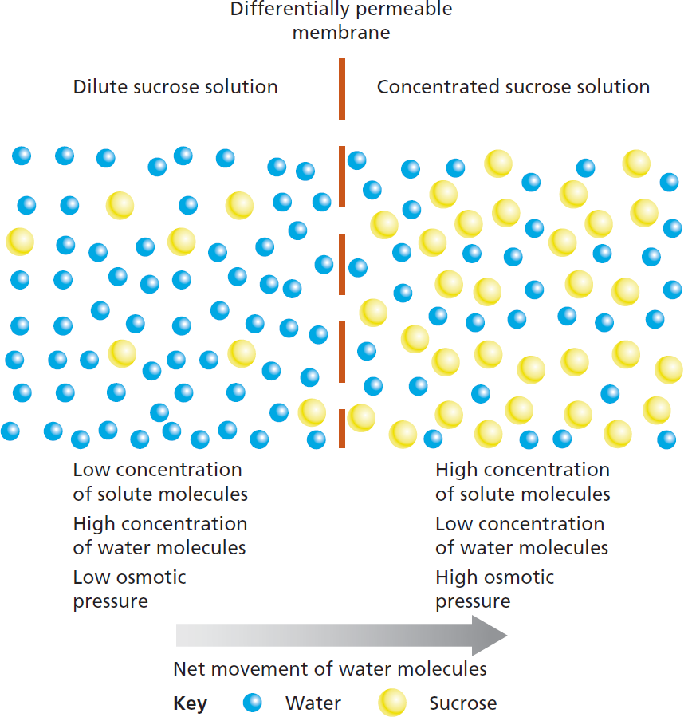
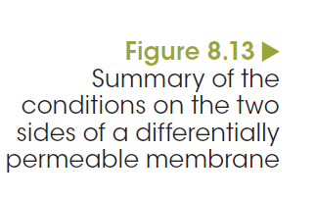
Osmosis: a special type of diffusion
Passive movement across membranes
Notes:
Plasma membranes are selectively (differentially) permeable, meaning that water molecules pass through them easily, but solutes do not. If the concentration of water molecules inside a cell is lower than the concentration outside, water will diffuse into the cell, until a balance or equilibrium is reached. This process is called osmosis. By definition, osmosis is the diffusion of water across a selectively permeable membrane from an area of high water concentration (low solute) to an area of low water concentration (high solute). Osmosis is a special type of diffusion and, like diffusion, requires no input of energy, as water is moving down its concentration gradient (Figure 8.13).

Slide 18
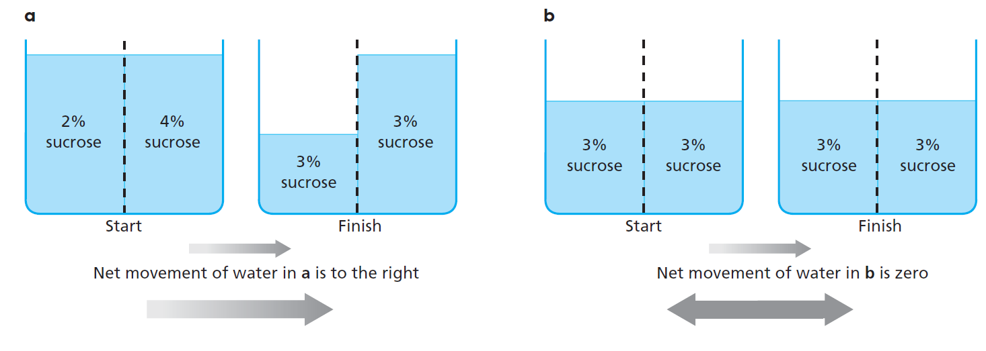
Osmosis: a special type of diffusion
Passive movement across membranes
Notes:
If the fluids inside and outside a cell are of equal solute concentration, the external solution is said to be isotonic (‘iso’ = same) to the cells; water molecules jostle on both sides of the membrane, moving in both directions equally.
When cells are surrounded by a solution that contains a lower solute concentration than their cytoplasm, the external solution is said to be hypotonic to the cells (‘hypo’ 5 lower). Water molecules will diffuse through the membrane into the cells. The reverse applies if the cells are surrounded by a solution of higher solute concentration; the external solution is hypertonic (‘hyper’ 5 higher) to the cells and water molecules will diffuse out.

Slide 19
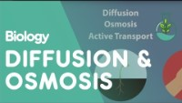
https://www.youtube.com/watch?v=PRi6uHDKeW4

Slide 20
Rules of Osmosis and Diffusion
All substances that enter or leave a cell must cross its surface
Small cells function better than large cells
WHY? ... because substances do not have to travel as far to reach the center of small cells
So, the larger the cell...the longer it takes
to cross it

Slide 21
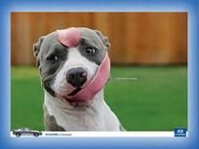
Have a Brilliant Day ☺

